Slide 1
The Minority Math Problem
Where to invest in new York city to elevate minority representation in mathematics

Slide 2
The Problem
National Center for Science and Engineering Statistics (NCSES) 2017 Women, Minorities, and Persons with Disabilities in Science and Engineering (WMPD) report
Findings:
A wide gap in educational attainment remains between underrepresented minorities and whites and Asians, two groups that have higher representation in S&E education than they do in the U.S. population.
White men constitute about one-third of the overall U.S. population; they comprise half of the S&E workforce. Blacks, Hispanics and people with disabilities are underrepresented in the S&E workforce.

Slide 3
The Data
NYC OPEN DATA
2015-2016 Pupil-Student Ratio
PASSNYC
2016 School Explorer Dataset
Economic Need Index
Student Attendance Rate
Percent of Students Chronically Absent
Rigorous Instruction %
Collaborative Teachers %
Supportive Environment %
Effective School Leadership %
Strong Family-Community Ties %
Trust %
Student Achievement Rating
Average Math Proficiency
Grade Range
Student to Teacher Ratio

Slide 4
Defining our Model
What is success in math?
Looking at the 4th quartile of math scores for NYC schools in the dataset, we define a high math score as ~ 2.98 or above (out of 4)
Recursive Feature Elimination (RFE)
Through recursive feature engineering, which takes smaller and smaller sets of features in a given classifier to identify feature importance, Collaborative Teachers %, Trust %, and Grade Range were eliminated

Slide 5


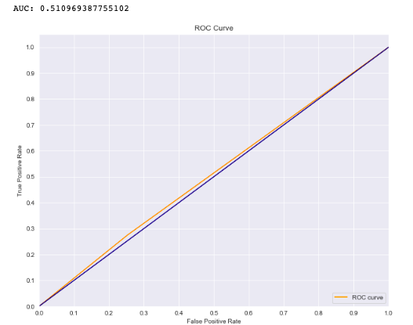
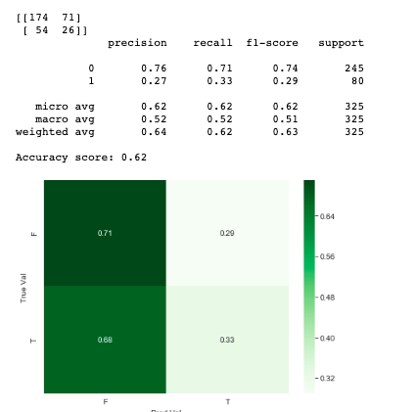



Model
Baseline

Slide 6
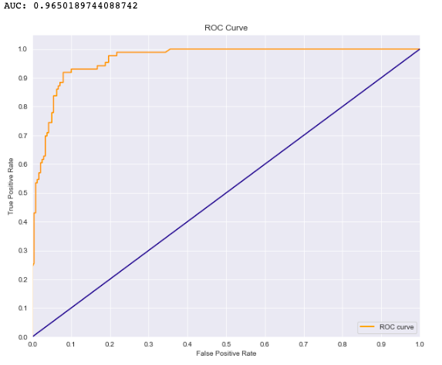
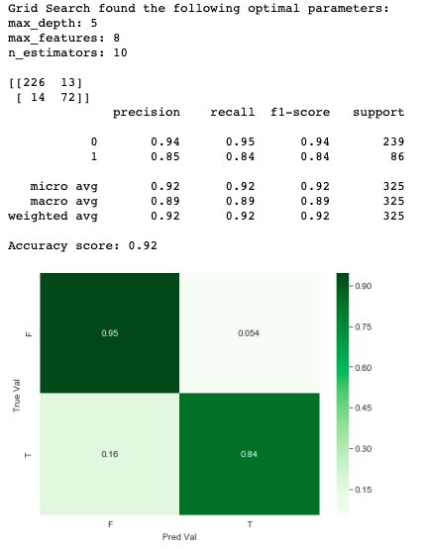
Model
Random Forest

Slide 7
Implementation
So we can predict math scores…
What do we do with this info?
The original problem statement – minorities in STEM
Where can we focus for the most impact?

Slide 8
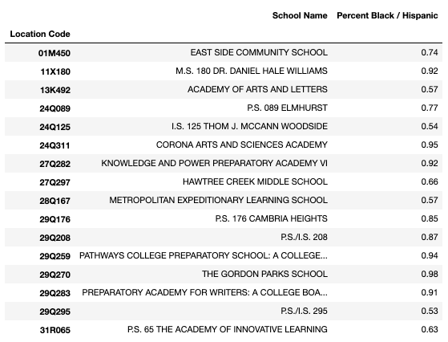
The Schools

Slide 9
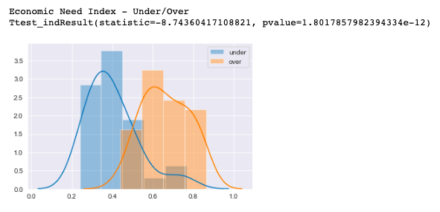
Investment
We need focused solutions, not just more funding
Economic Need: % temp housing + % HRA eligible *0.5 + % free lunch eligible *0.5

Slide 10
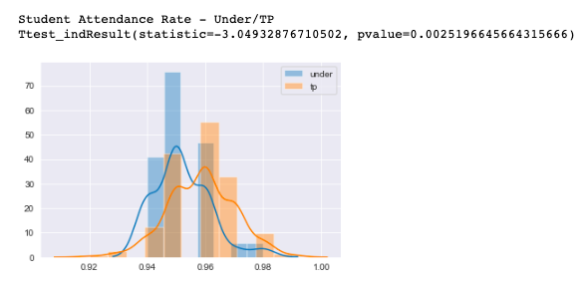
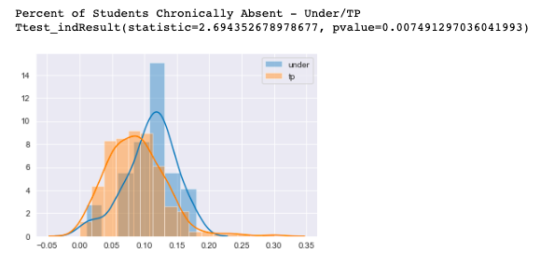
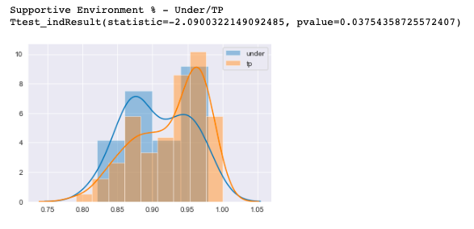
Investment
What can we improve?

